Slide 1
Web Engineering
Ms Nabeela Bibi

Slide 2
Course Aims
Introduced methods and techniques use in web based application development
Methods and techniques to develop practical web based applications
All about designing and promoting web based system

Slide 3
Software Engineering
Process of analyzing user requirements and then designing, building, and testing software application which will satisfy those requirements.
Concerned with all aspects of software production.
SE is science and arts of building a good and efficient software system that are on time, on budget, with correct operations, acceptable and good performance.

Slide 4
What is Web Engineering?
Web engineering is study of processes, concepts , methonis, and techniques used to create high quality web applications.
Web Engineering is the application of systematic and computable approaches to cost effective requirements analysis, design, implementation, testing, operation, and maintenance of high quality web applications.

Slide 5
The Case for Web Engineering
Web Engineering is multidisciplinary, no single discipline
Web development process is different and unique
Individual experience
Little or no documentation for code/design
Short-term savings lead to long-term problems in operation, maintenance, usability, etc.

Slide 6
The Case for Web Engineering
Root causes of poor design:
Development as an authoring activity
Development is “easy”
Techniques that should not be used are misapplied.
Techniques that should be used are not.
Particularly alarming given…
Most projects are now web-based
Most “mission-critical” apps moving to the web

Slide 7
The Case for Web Engineering
Web Engineering’s solution:
Clearly defined goals and objectives
Systematic, phased development
Careful planning
Iterative and continuous auditing of the entire process

Slide 8
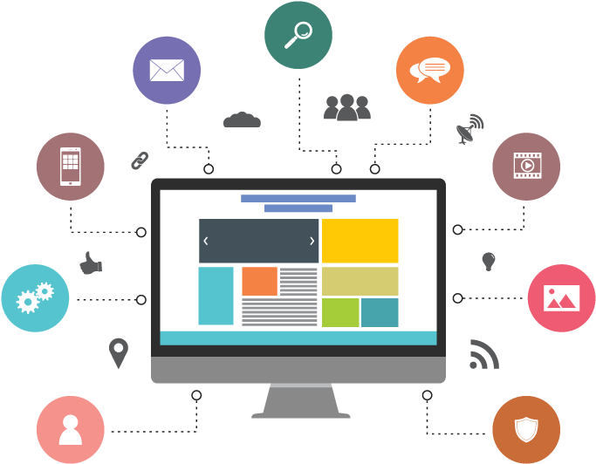
Web Based Application
A web based application is a software package that can be accessed through the web browser. The software and database reside on a central server rather than being installed on the desktop system and is accessed over a network.

Slide 9

Attributes of Web-based Application
There are three main attributes of web-based application:
Network intensive
Content Driven
Continuous Evolution

Slide 10
Network intensive
Web application is network intensive. It resides on a network and must serve the need of a diverse community of clients. A web application may reside on an internet, intranet, and extranet.
WebApp may reside on the Internet (thereby enabling open worldwide communication).
Alternatively (Otherwise), an application may be placed on an intranet (implementing communication across an organization) or
An Extranet (internetwork communication)

Slide 11
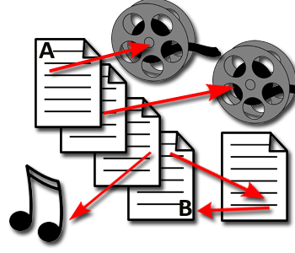
Content Driven
The primary function of a web application is to use hyper (more active than normal) media to present text, graphics, audio, video, contents to the end users.

Slide 12
Continuous Evolution
Unlike conventional application software that evolves (develop) over a series of planned releases.
Most web applications evolve continuously.
These applications updated on the regular interval, even some applications are updated on hourly schedule to provide latest information to the end users.

Slide 13
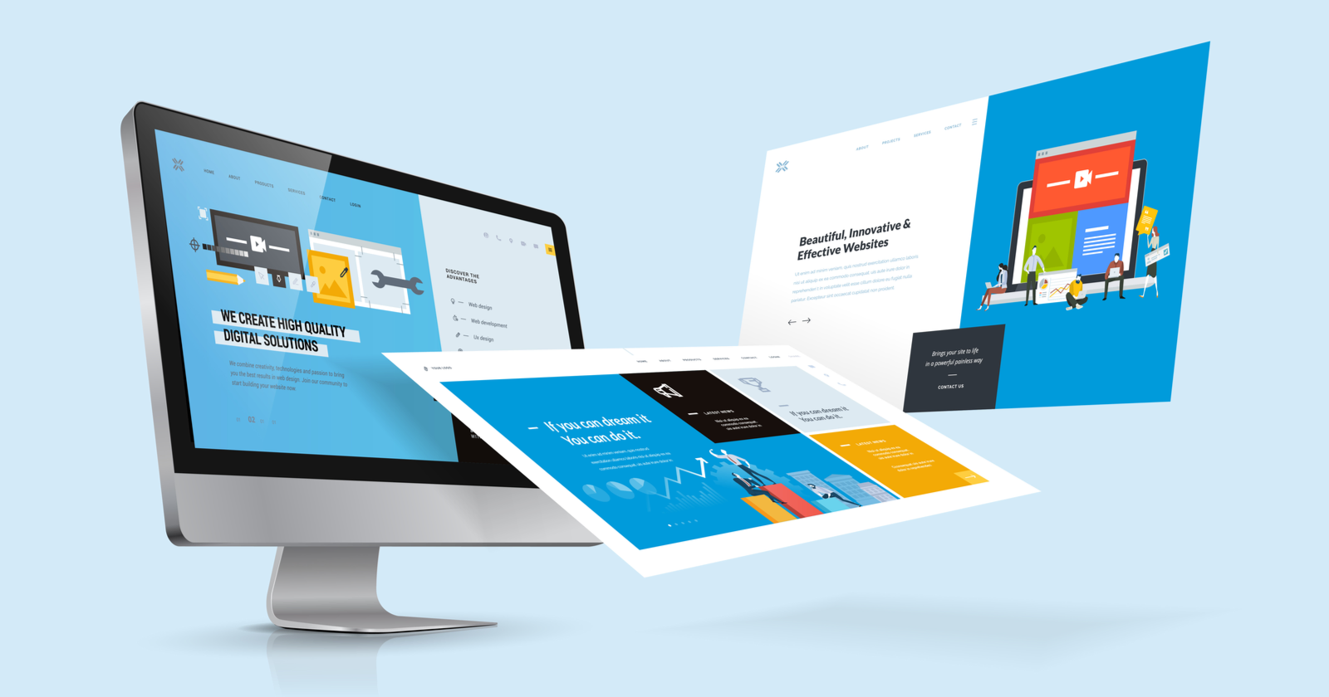
Quality Web Design
Think Before You Write
Highlight the benefits of the product.
Explain how it differs from other products.
Persuade customers to buy it.
Make Your Content Informative
Features And Benefits
Proofread And Spell Check
Never Post Your First Draft

Slide 14
Recommended Books
1. Learning PHP, MySQL & JavaScript: With JQuery, CSS & HTML5 by Robin Nixon (5th edition ,2018)
2. HTML & CSS: Design and Build Web Sites by Jon Ducket (1st edition 2011)

Slide 15


